Slide 1

FUNDAMENTAL ENGINEERING Class – 01 Introduction to programming in c/c++ October 2025
School of Engineering

Slide 2

Introduction to programming in C
id | Date | Topic | Activities
1 | 23/10/2025 | Introduction to C | Lesson
2 | 29/10/2025 | Programming in C | Practical
3 | 6/11/2025 | Arduino programming | Lesson
4 | 13/11/2025 | Arduino programming | Practical
5 | 20/11/2025 | Arduino programming | Practical
6 | 27/11/2025 | Arduino | Final Project

Slide 3
At it end of the lesson you will be able to:
Know about the base concepts in C programming.
Use the structured thinking to solve problems.
Insert and display results as output.
Solve problem using loops and integrations.

Slide 4


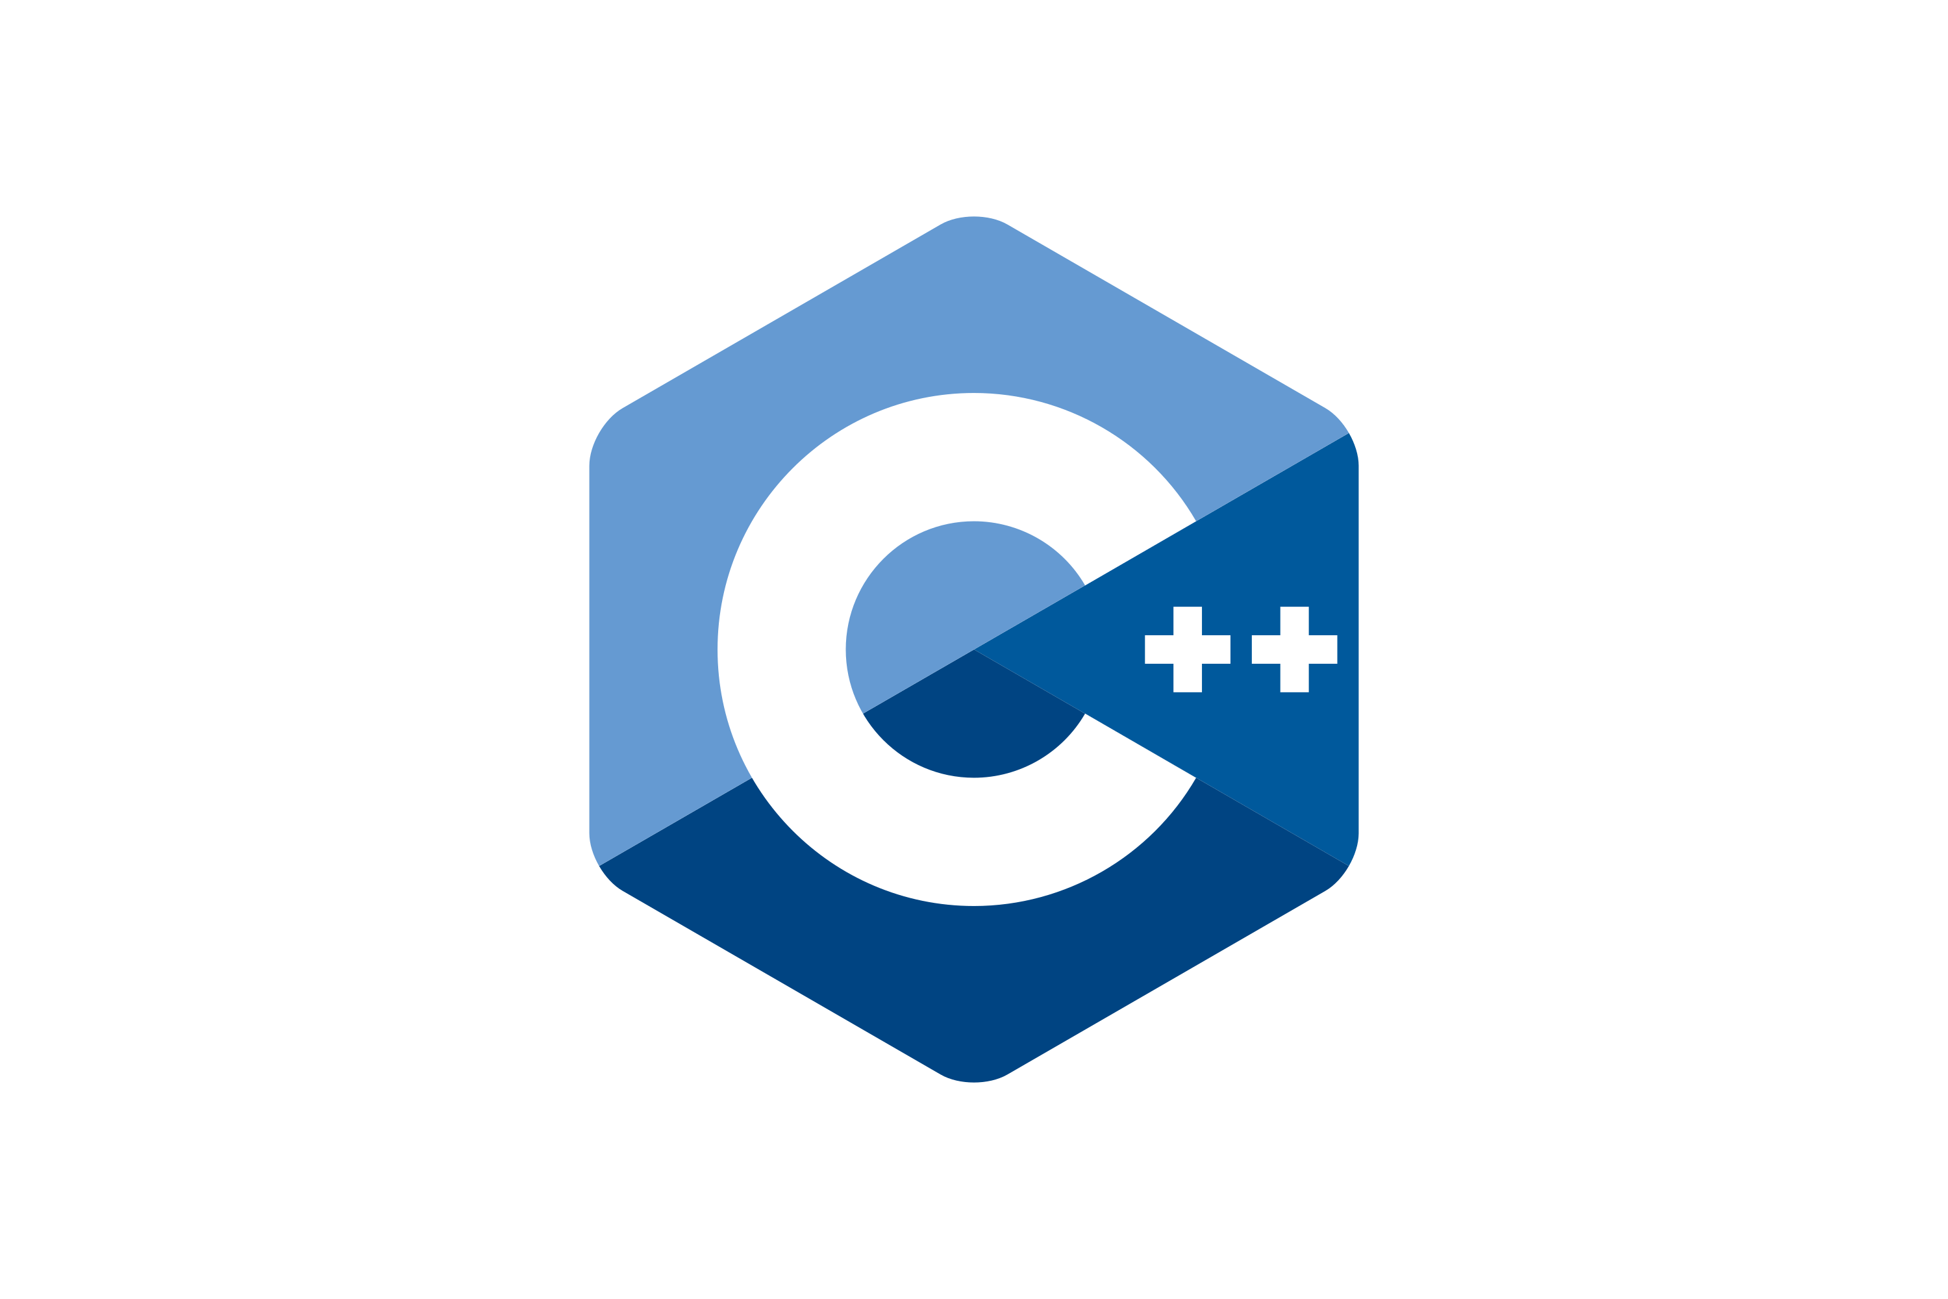


What's is C
C is a general-purpose programming language created by Dennis Ritchie at the Bell Laboratories in 1972. The main reason for its popularity is because it is a fundamental language in the field of computer science.
HIGH LEVEL
LOW LEVEL

Slide 5
Algorithm
“Algorithm is a sequence of steps that aims to achieve a well-defined objective” (FORBELLONE, 1999).
Algorithm 2 - Making a sandwich
Step 1 | Get the bread.
Step 2 | Cut the bread in half.
Step 3 | Get the mayonnaise.
Step 4 | Spread the mayonnaise on the bread.
Step 5 | Get and cut the lettuce and tomato.
Step 6 | Put the lettuce and tomato on the bread.
Step 7 | Get the hamburger.
Step 8 | Fry the hamburger.
Step 9 | Put the hamburger on the bread.
Algorithm 1 - Add three numbers
Step 1 | Receive the three numbers.
Step 2 | Add the three numbers.
Step 3 | Display the result obtained.

Slide 6
Narrative Description
The narrative description consists of analyzing the problem statement and writing, using a natural language (for example, Dutch or English), the steps to be followed to solve it.
Advantage: it is not necessary to learn any new concepts, since a natural language, at this point, is already well known.
Disadvantage: it leaves it open to various interpretations, which will subsequently make it difficult to transcribe this algorithm into a program.
Create an algorithm to show the result of multiplying two numbers.
Algorithm in narrative description:
Step 1 — Receive two numbers that will be multiplied.
Step 2 — Multiply the numbers.
Step 3 — Show the result obtained in the multiplication.

Slide 7
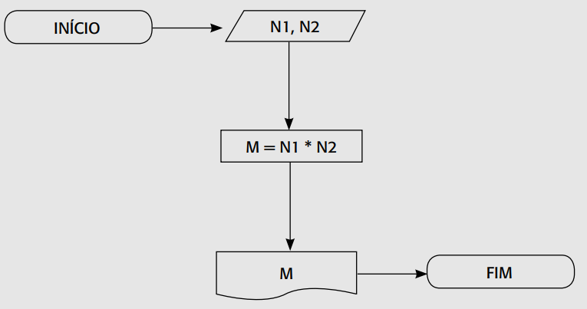
Flowchart
A flowchart consists of analyzing the problem statement and writing, using predefined graphic symbols, the steps to be followed to solve it.
Advantage: understanding graphic elements is simpler than understanding texts.
Disadvantage: it is necessary to learn the symbology of flowcharts and, in addition, the resulting algorithm does not present many details, making it difficult to transcribe into a program.
Create an algorithm to show the result of multiplying two numbers.
Algorithm in Flowchart:
Start
Stop

Slide 8
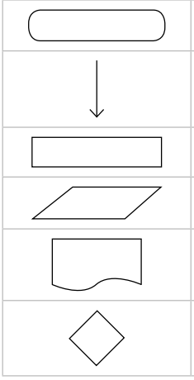
Flowchart
Symbol used to indicate the beginning and end of the algorithm.
Symbol used to indicate the direction of the data flow. It is used exclusively to connect existing symbols or blocks.
Symbol used to indicate calculations and value assignments.
Symbol used to represent data input.
Symbol used to represent data output.
Symbol used to indicate that a decision must be made, indicating the possibility of deviations.

Slide 9
Pseudocode
Create an algorithm to show the result of multiplying two numbers.
Algorithm in Pseudocode:
Algorithm
DECLARE N1, N2, M NUMERIC
WRITE “Enter two numbers”
READ N1, N2
M ← N1 * N2
WRITE “Multiplication = “, M
END_ALGORITHM.
Pseudocode consists of analyzing the problem statement and writing, using predefined rules, the steps to be followed to solve it.
Advantage: the algorithm can be transferred to any programming language almost immediately, as long as you know the reserved words of the language that will be used.
Disadvantage: it is necessary to learn the rules of pseudocode.

Slide 10
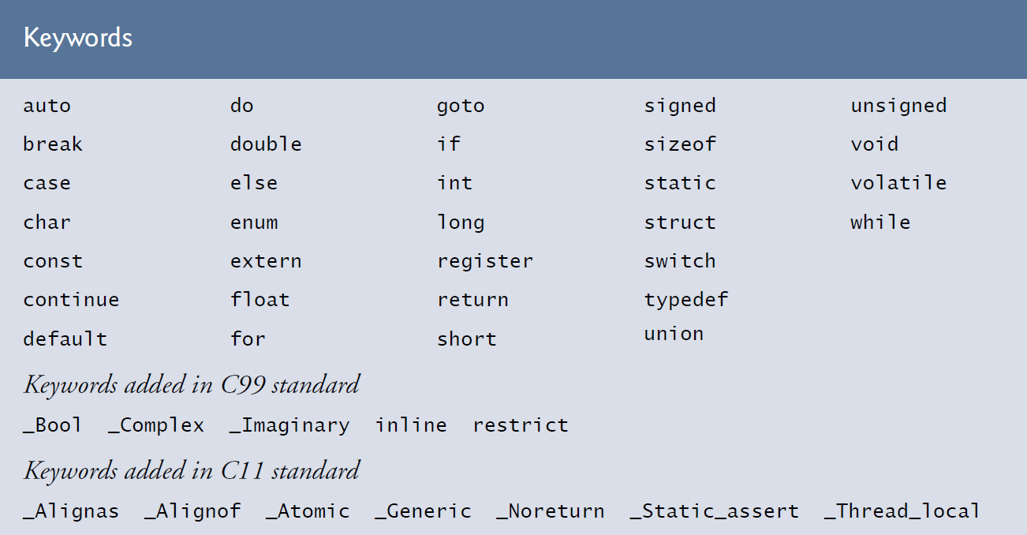
Reserved words
keywords or reserved words of the language.

Slide 11

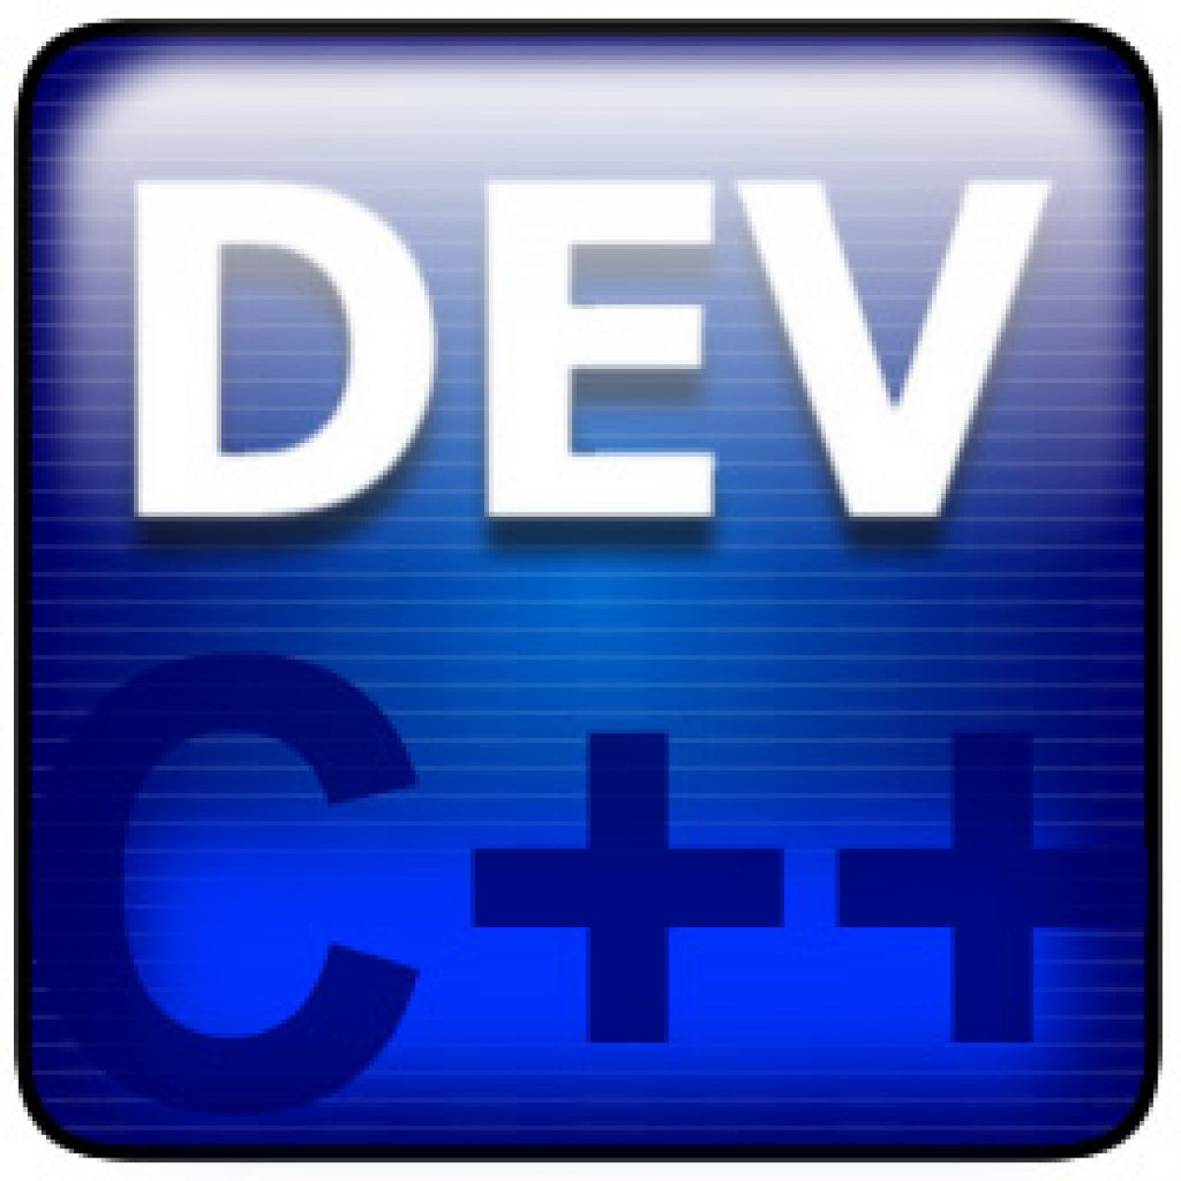

IDE
An IDE stands for Integrated Development Environment.
It’s a software application that provides everything a programmer needs to write, test, and debug code — all in one place.
Code::Blocks Dev-C++ CLion Visual Studio

Slide 12
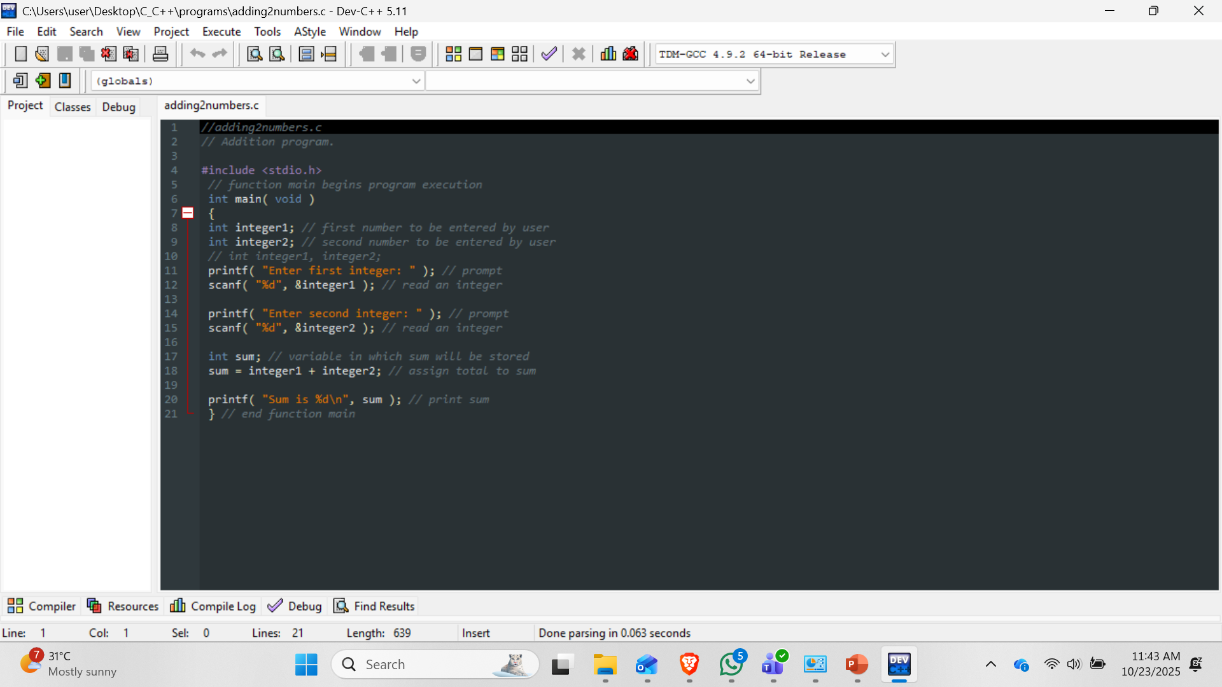
IDE – DEV C/C++
https://sourceforge.net/projects/orwelldevcpp/
DEV C/C++

Slide 13
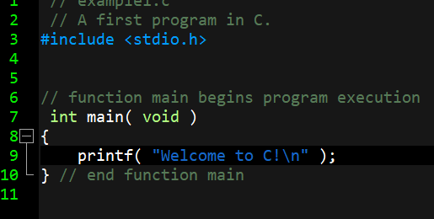
Introduction to C programming
Line 3 tells the preprocessor to include the contents of the standard input/output header (<stdio.h>) in the program.
Line 4 is simply a blank line. You use blank lines, space characters and tab characters (i.e., “tabs”) to make programs easier to read. Together, these characters are known as white space. White-space characters are normally ignored by the compiler.
Line 7 is a part of every C program. The parentheses after main indicate that main is a program building block called a function. The void in parentheses here means that main does not receive any information.

Slide 14
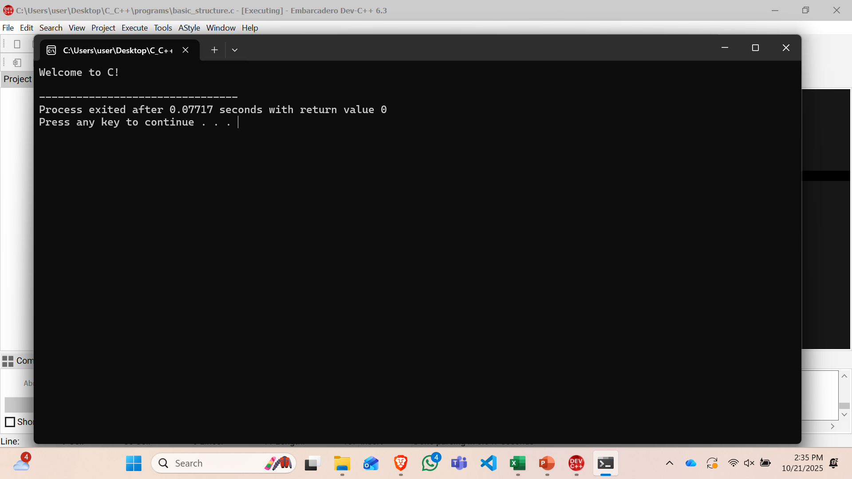
Introduction to C programming
left brace, {, begins the body of every function (line 8). A corresponding right brace ends each function (line 10). This pair of braces and the portion of the program between the braces is called a block. The block is an important program unit in C.
instructs the computer to perform an action, namely to print on the screen the string of characters marked by the quotation marks.

Slide 15
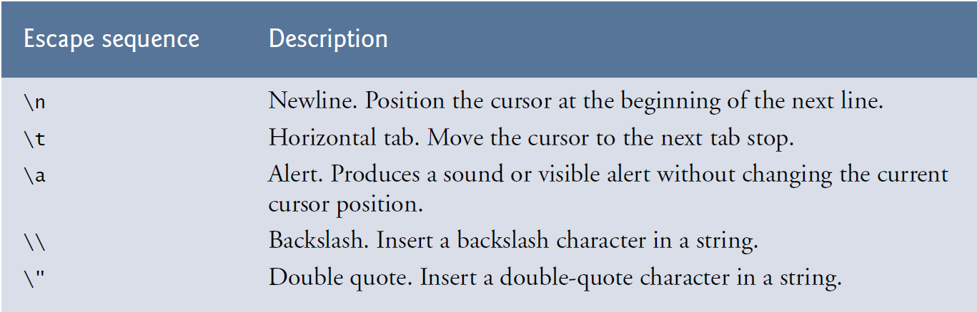
Introduction to C programming
Escape Sequences

Slide 16
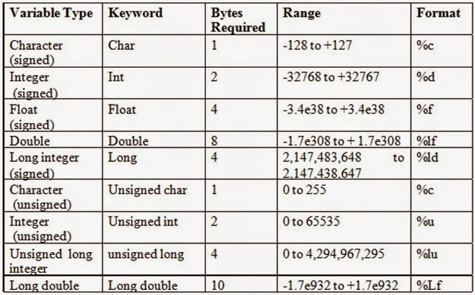
Data types in C

Slide 17
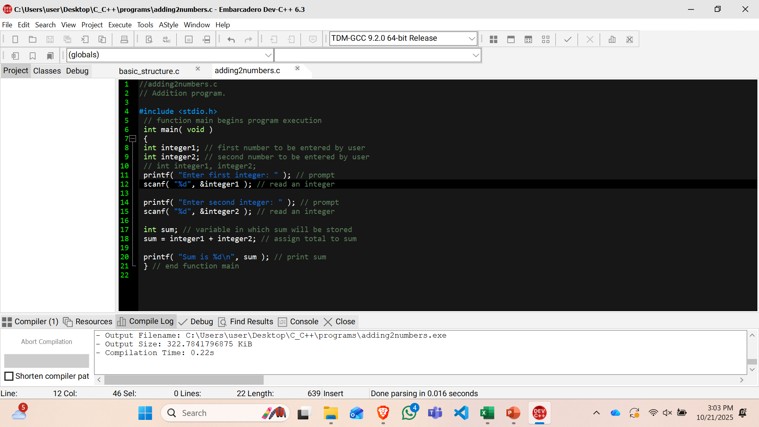
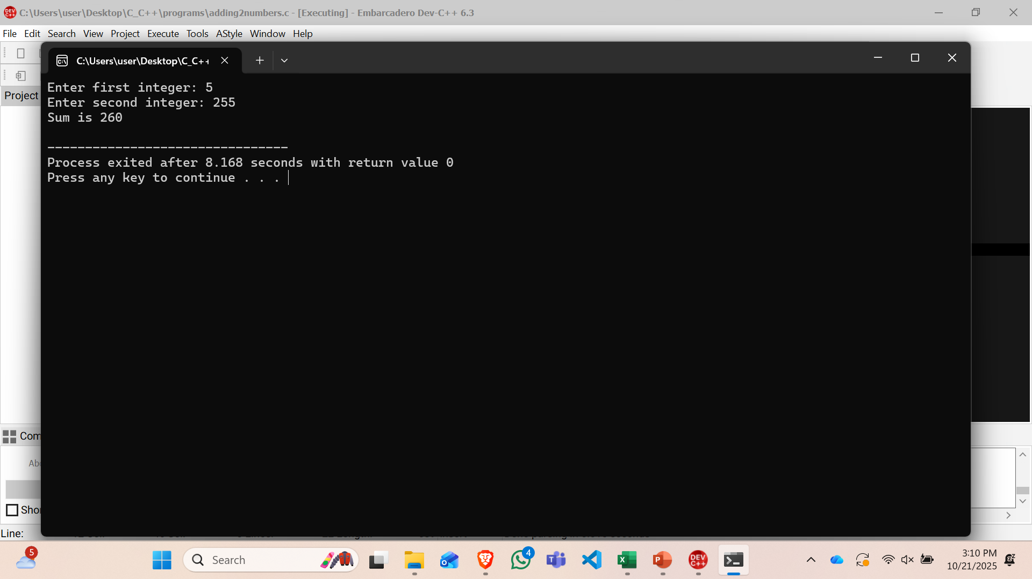
Adding two integers
uses scanf (the “f” stands for “formatted”) to obtain a value from the user. The function reads from the standard input, which is usually the keyboard.

Slide 18
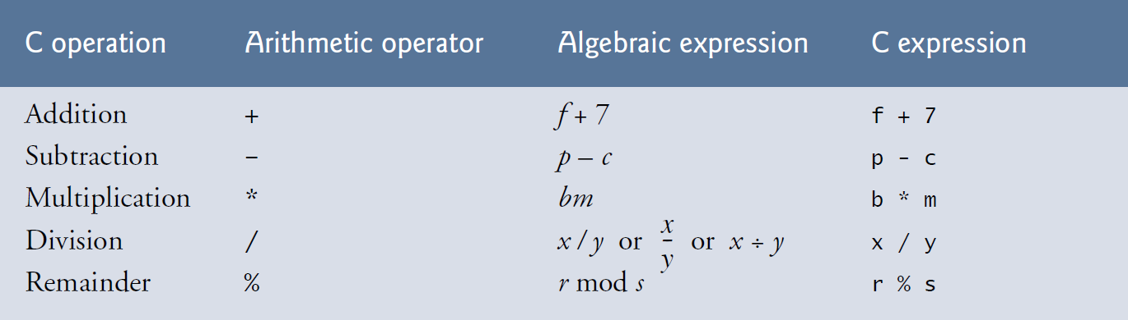
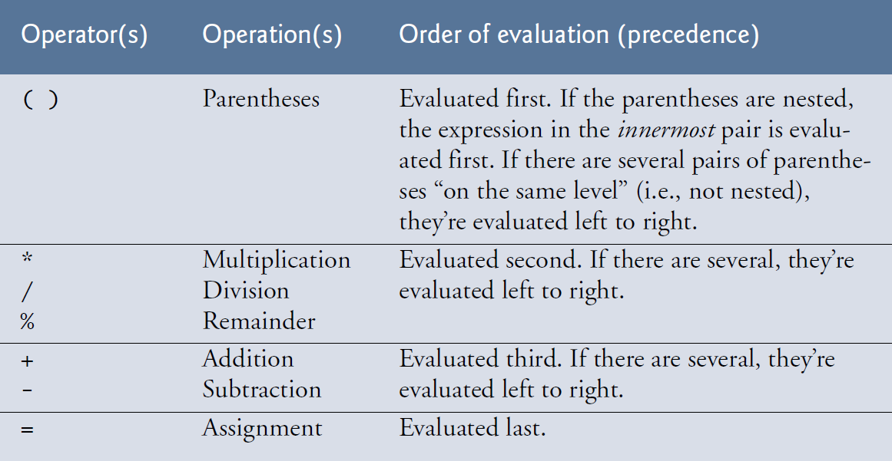
Arithmetic in C

Slide 19
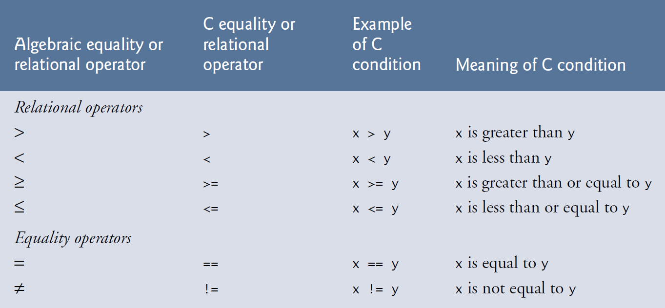
Decision Making
Decision Making: Equality and Relational Operators

Slide 20
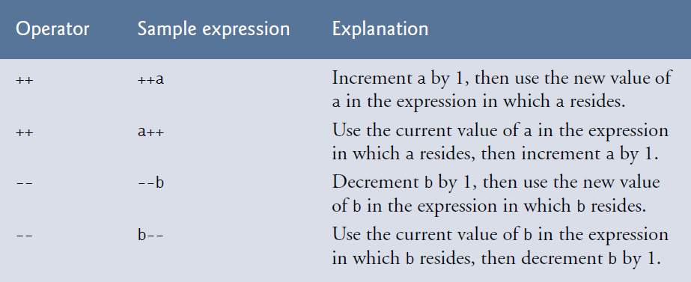
Increment and decrement operators
11 c = 5; // assign 5 to c
12 printf( "%d\n", c ); // print 5
13 printf( "%d\n", c++ ); // print 5 then postincrement
14 printf( "%d\n\n", c ); // print 6
15
16 // demonstrate preincrement
17 c = 5; // assign 5 to c
18 printf( "%d\n", c ); // print 5
19 printf( "%d\n", ++c ); // preincrement then print 6
20 printf( "%d\n", c ); // print 6
21 } // end function main
1 // example.c
2 // Preincrementing and postincrementing.
3 #include <stdio.h>
4
5// function main begins program execution
6 int main( void )
7 {
8 int c; // define variable
9
10 // demonstrate postincrement

Slide 21
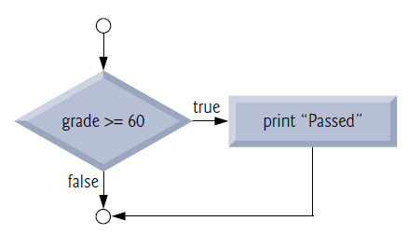
The if statement
If student’s grade is greater than or equal to 60
Print “Passed”
if ( grade >= 60 ) {
printf( "Passed" );
} // end if

Slide 22

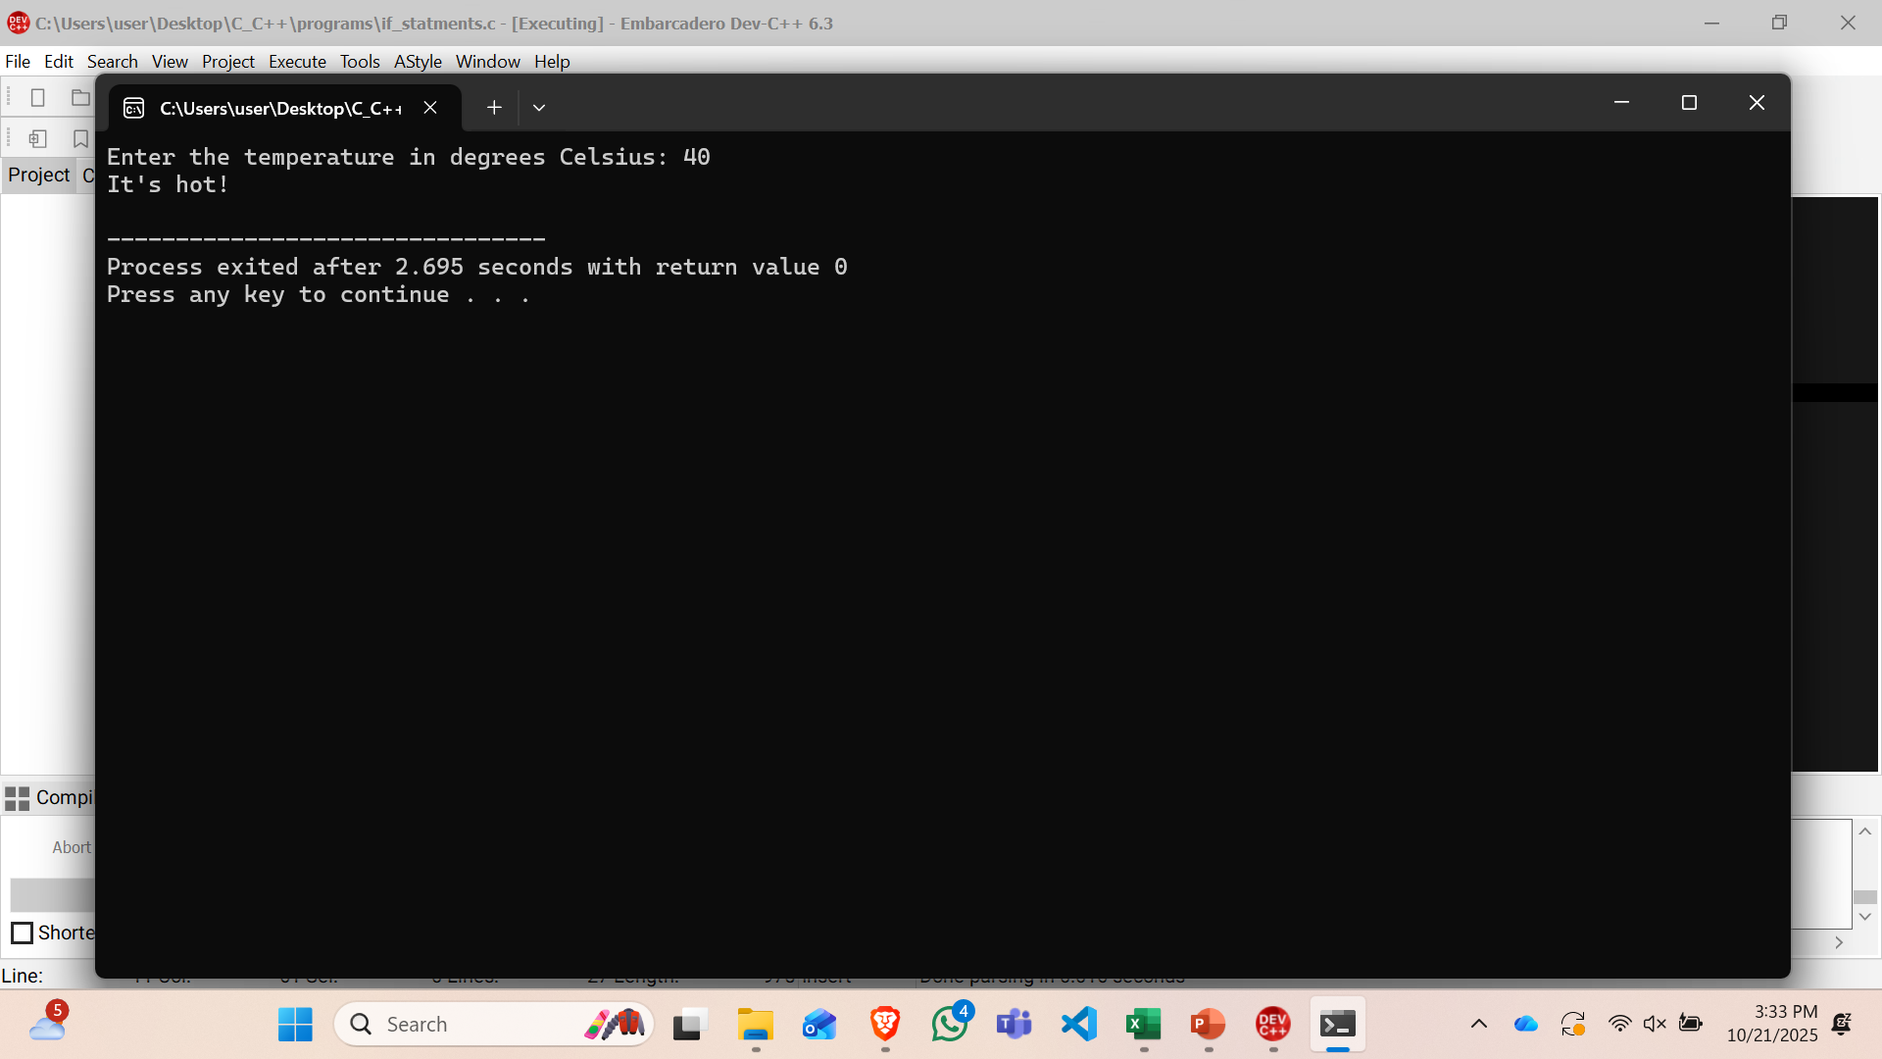
The if statement

Slide 23
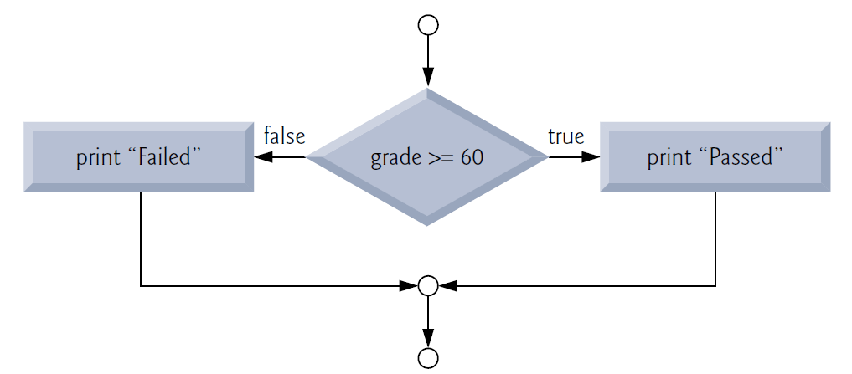
The if…else statement
If student’s grade is greater than or equal to 60
Print “Passed”
else
Print “Failed”
if ( grade >= 60 ) {
puts( "Passed" );
} // end if
else {
puts( "Failed" );
} // end else

Slide 24
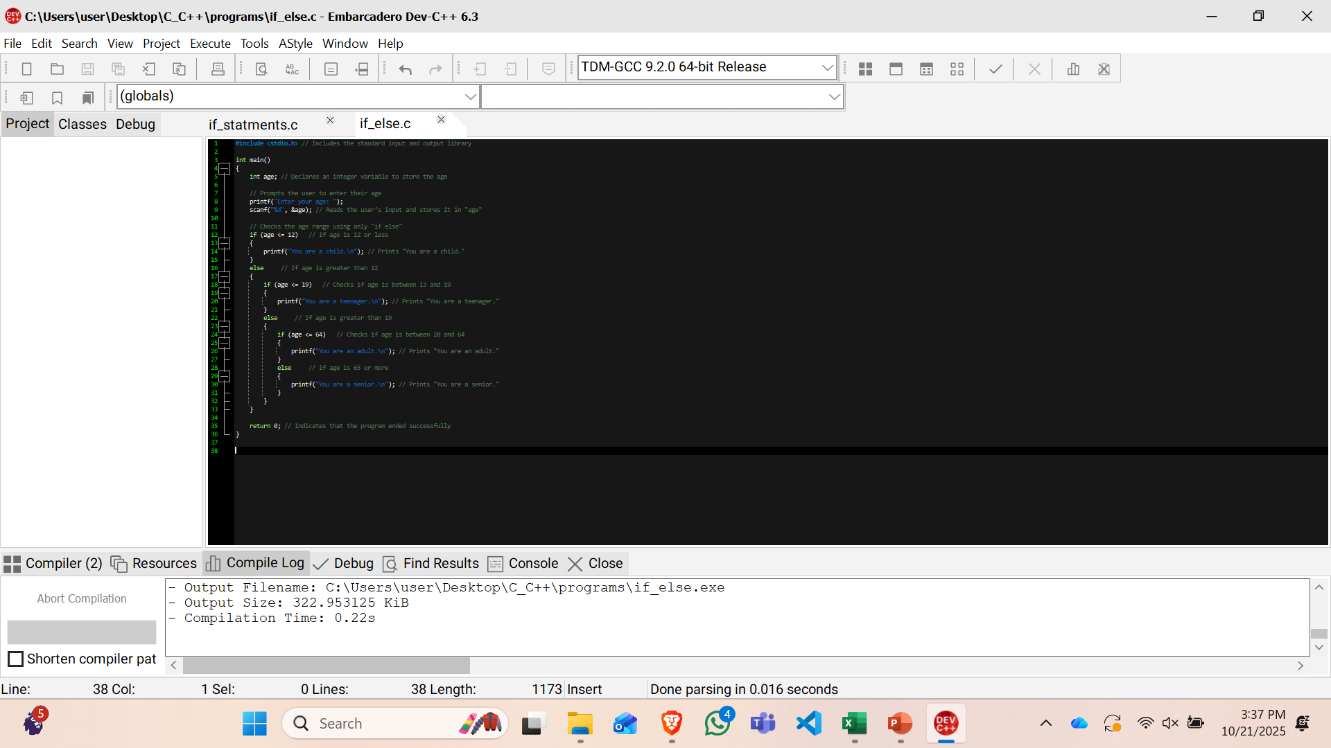
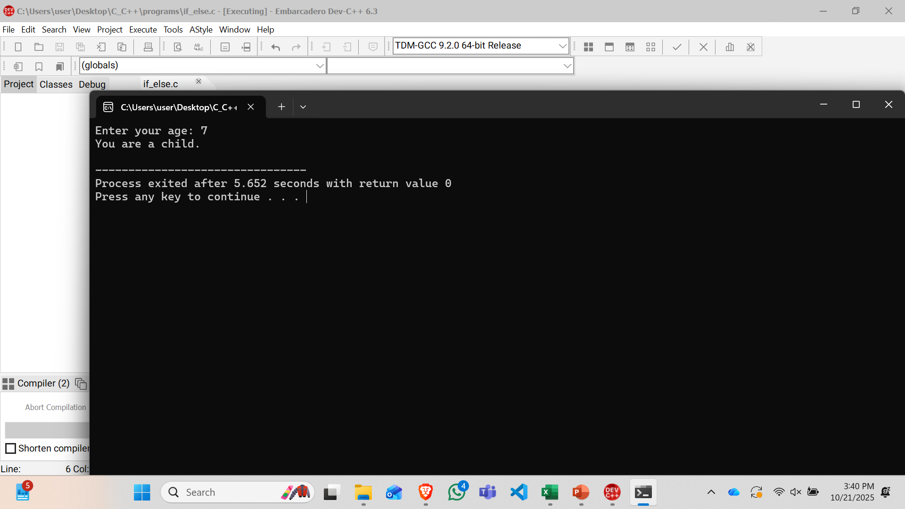
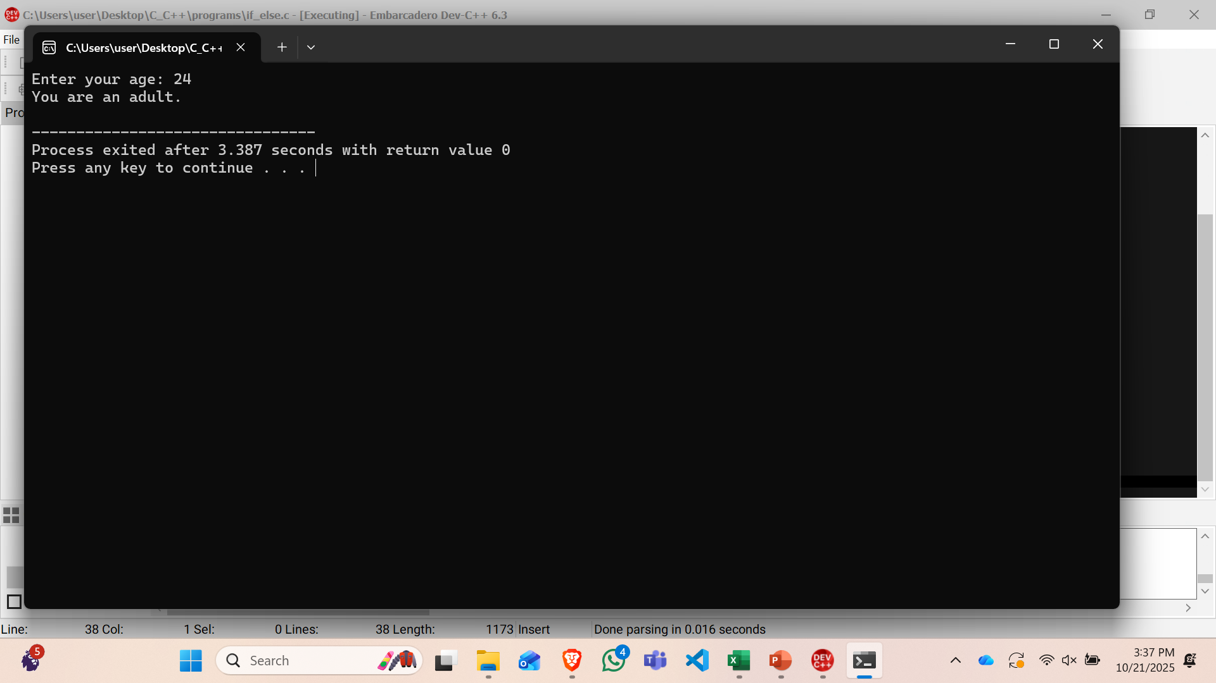
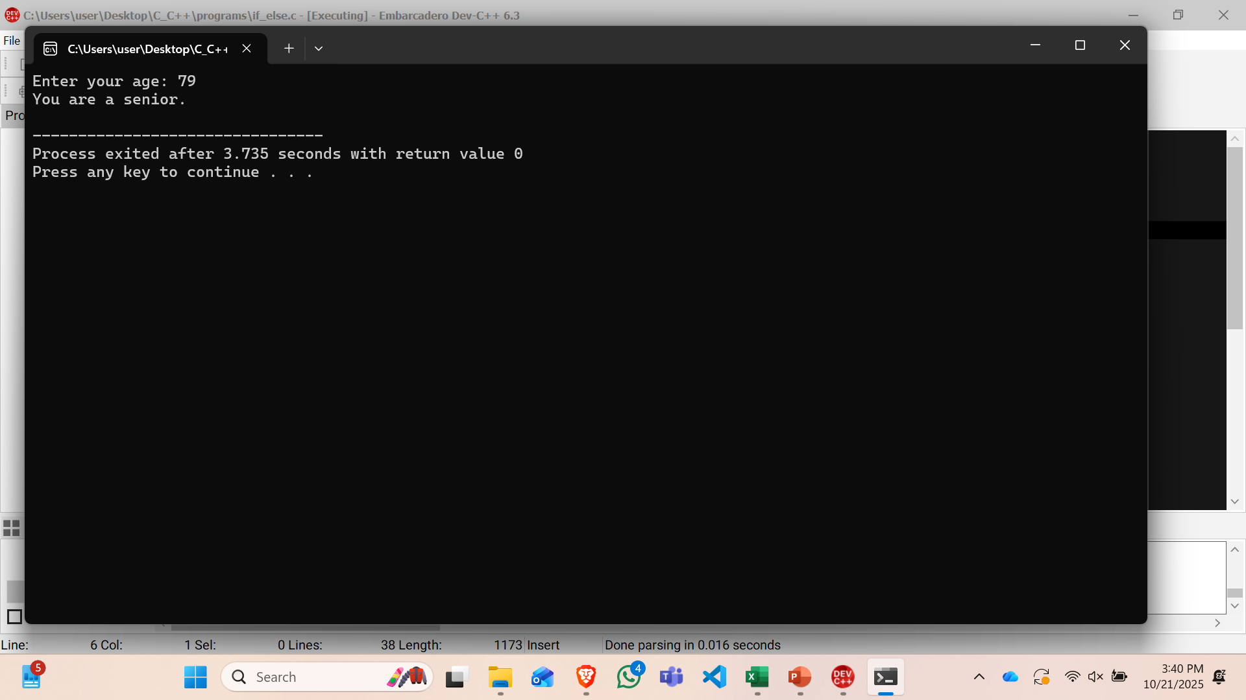
The if…else statement

Slide 25
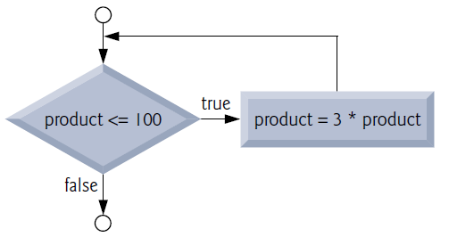
The while iteration statement
While there are more items on my shopping list
Purchase next item and cross it off my list
product = 3;
while ( product <= 100 ) {
product = 3 * product;
}

Slide 26
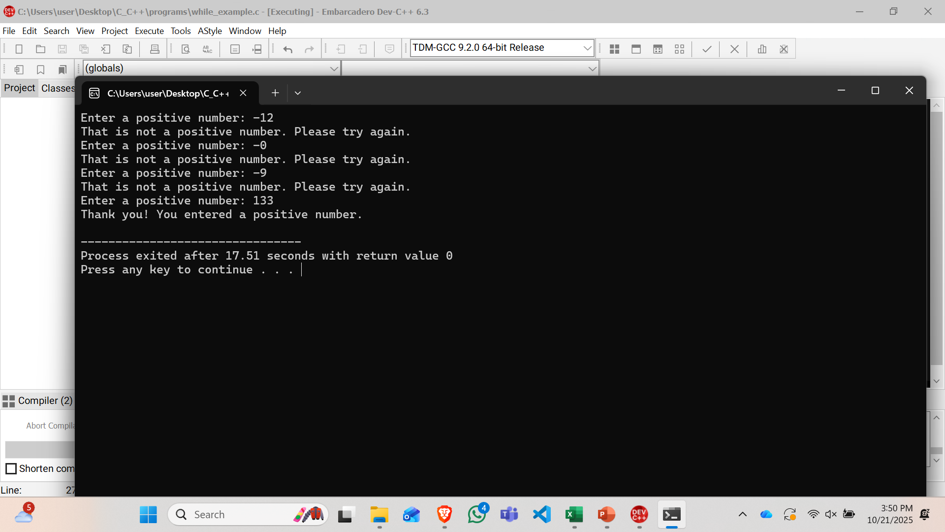
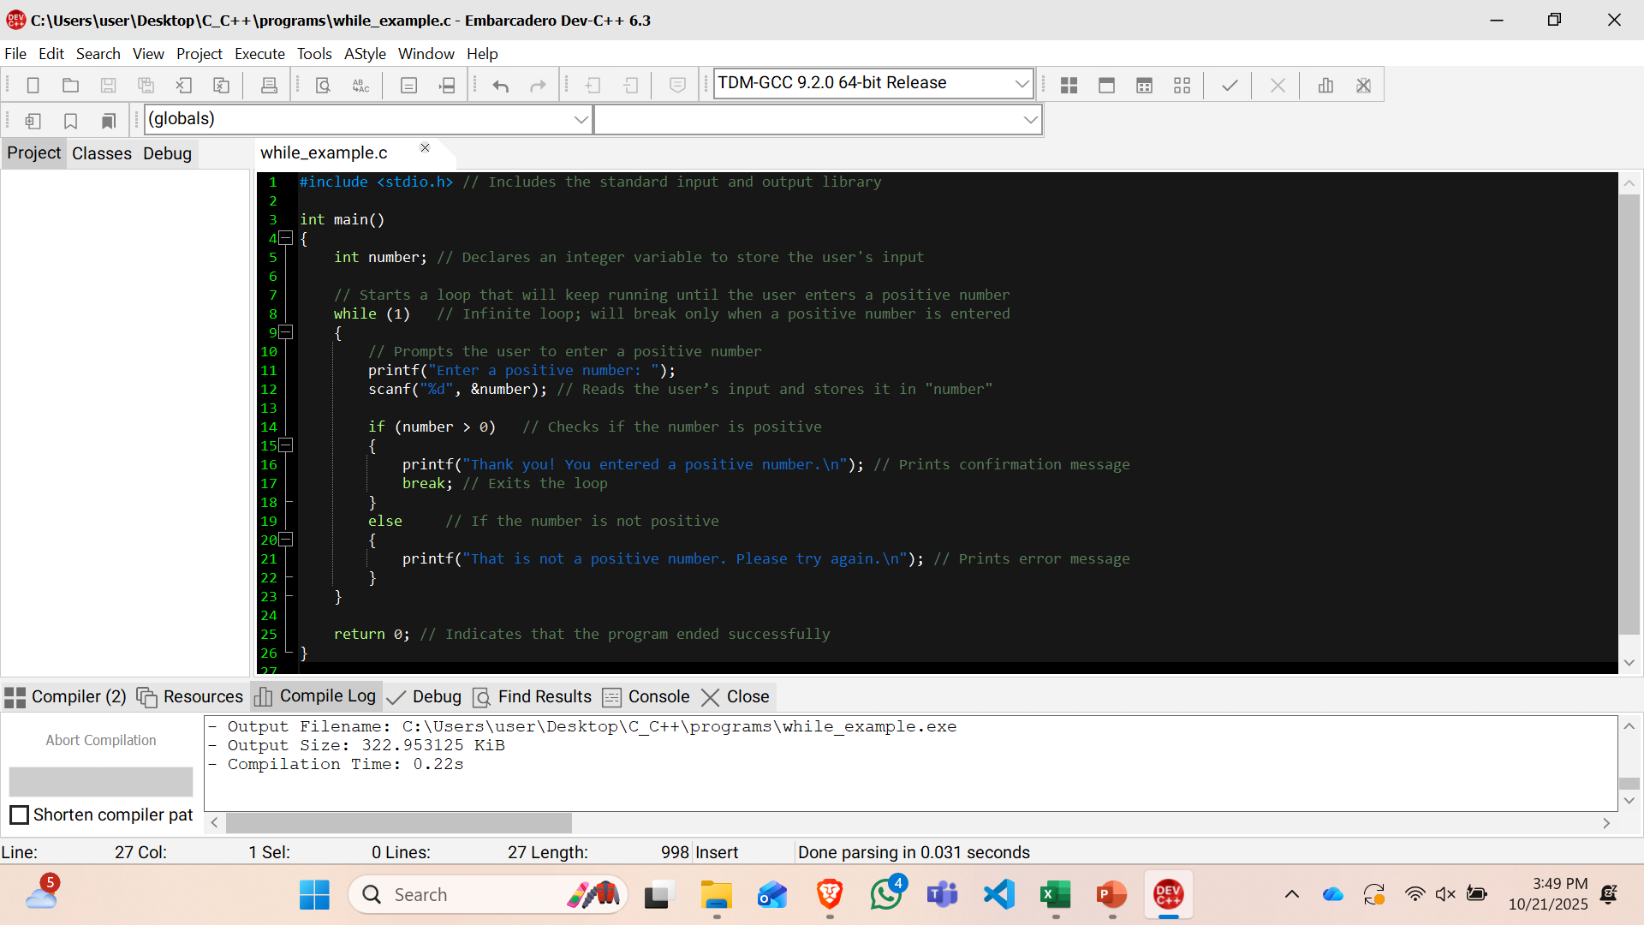
The while iteration statement

Slide 27
The for-iteration statement
for (initialization; condition; increment) {
statement
}
for (int i = 1; i <= 10; i++) {
printf("%d\n", i);
}
For i=1; i<=10;i++
true
Increment
false

Slide 28
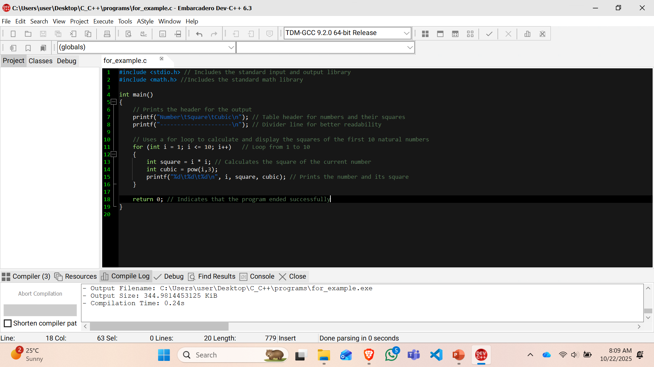
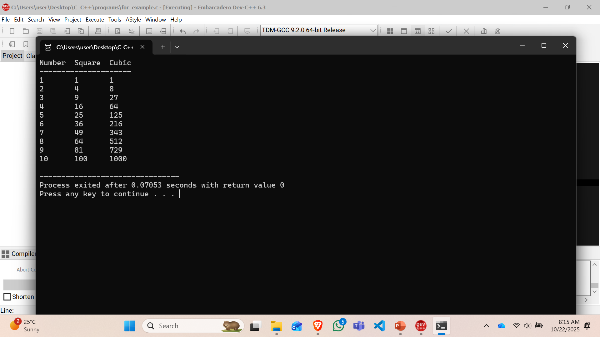
The for-iteration statement

Slide 29
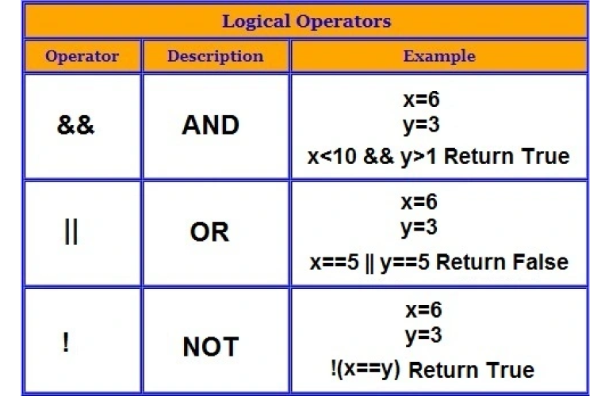
Logical Operators
Logical AND (&&) Operator
Logical OR (||) Operator
Logical Negation (!) Operator

Slide 30
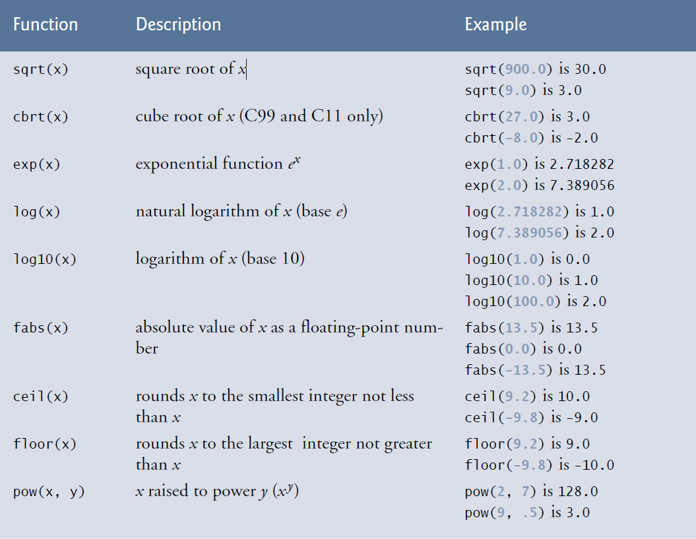
Math Library Functions
Using: #include <math.h>

Slide 31
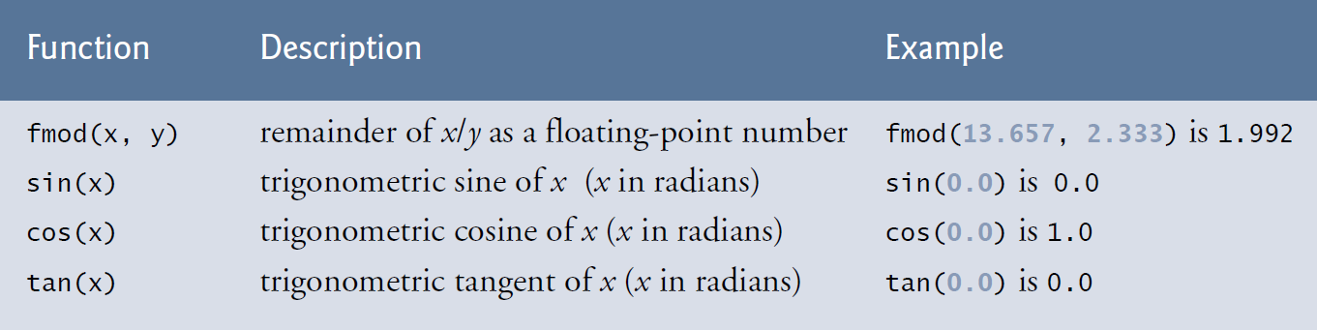
Math Library Functions

Slide 32
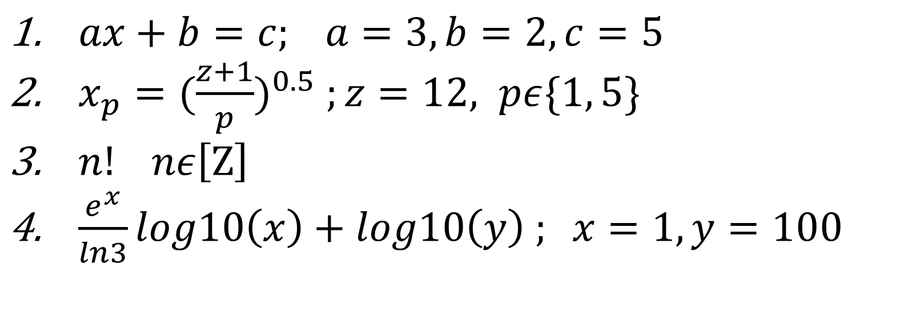
Assignment
Solve the following equations
$ax+b=c; a=3, b=2, c=5$
$x_{p}={(\frac{z+1}{p})}^{0.5} ;z=12, pε\{1, 5\}$
$n! nε\left[Ζ\right]$
$\frac{e^{x}}{ln3}log10\left(x\right)+log10\left(y\right) ; x=1, y=100$

Slide 33
Questions?
Thank you for your attention!!!

